Slide 1




Executive Search and EoR (Employer of Record)
Where Talent Meets Opportunities: Discover People, Unlock Possibilities.

Slide 2


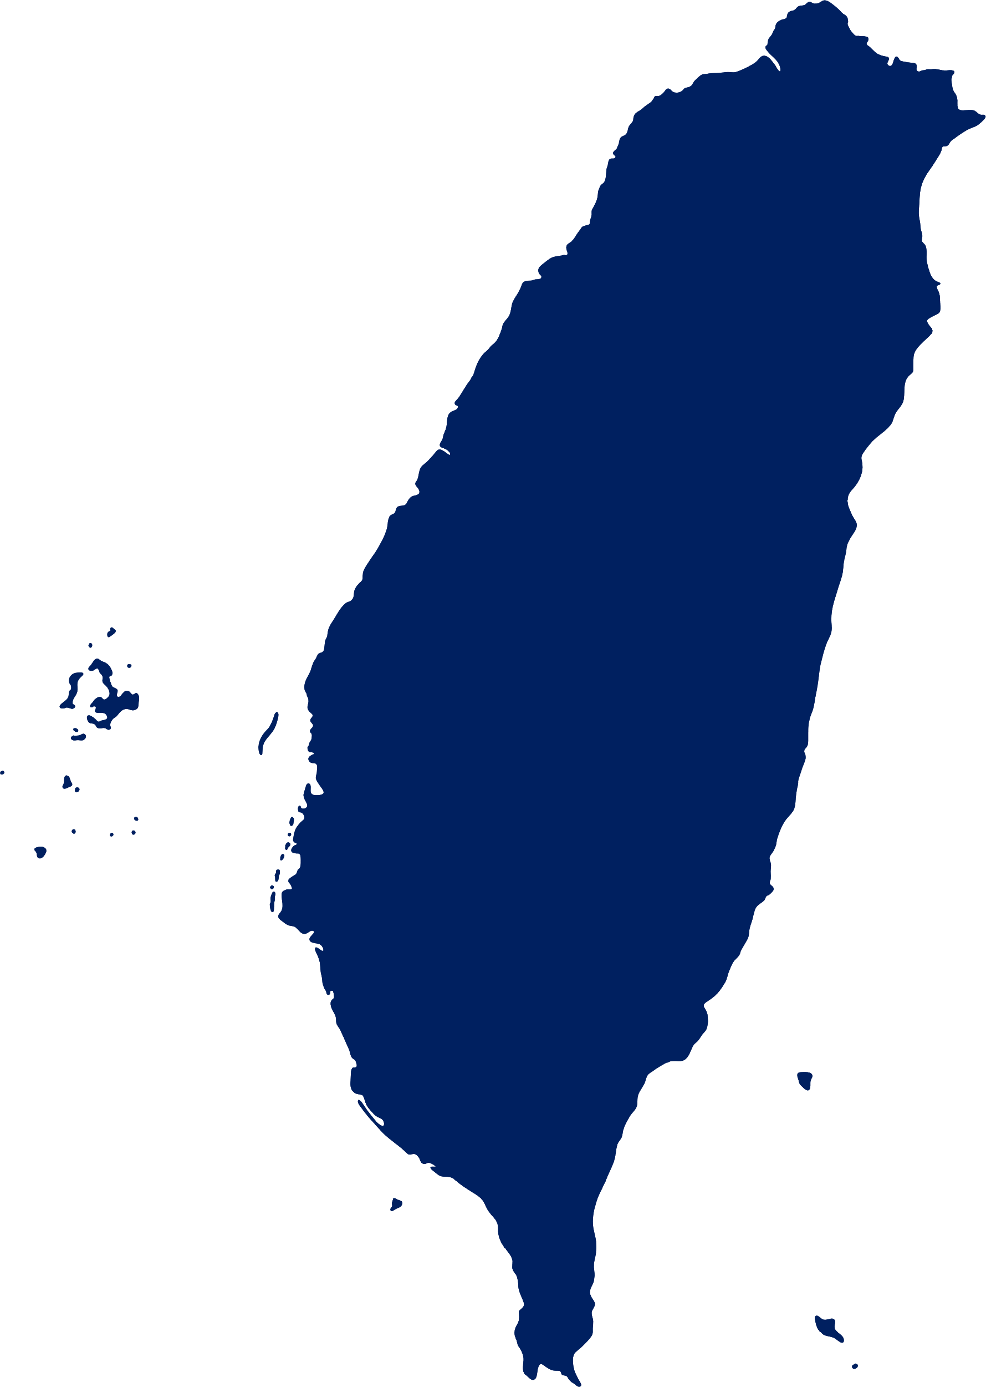


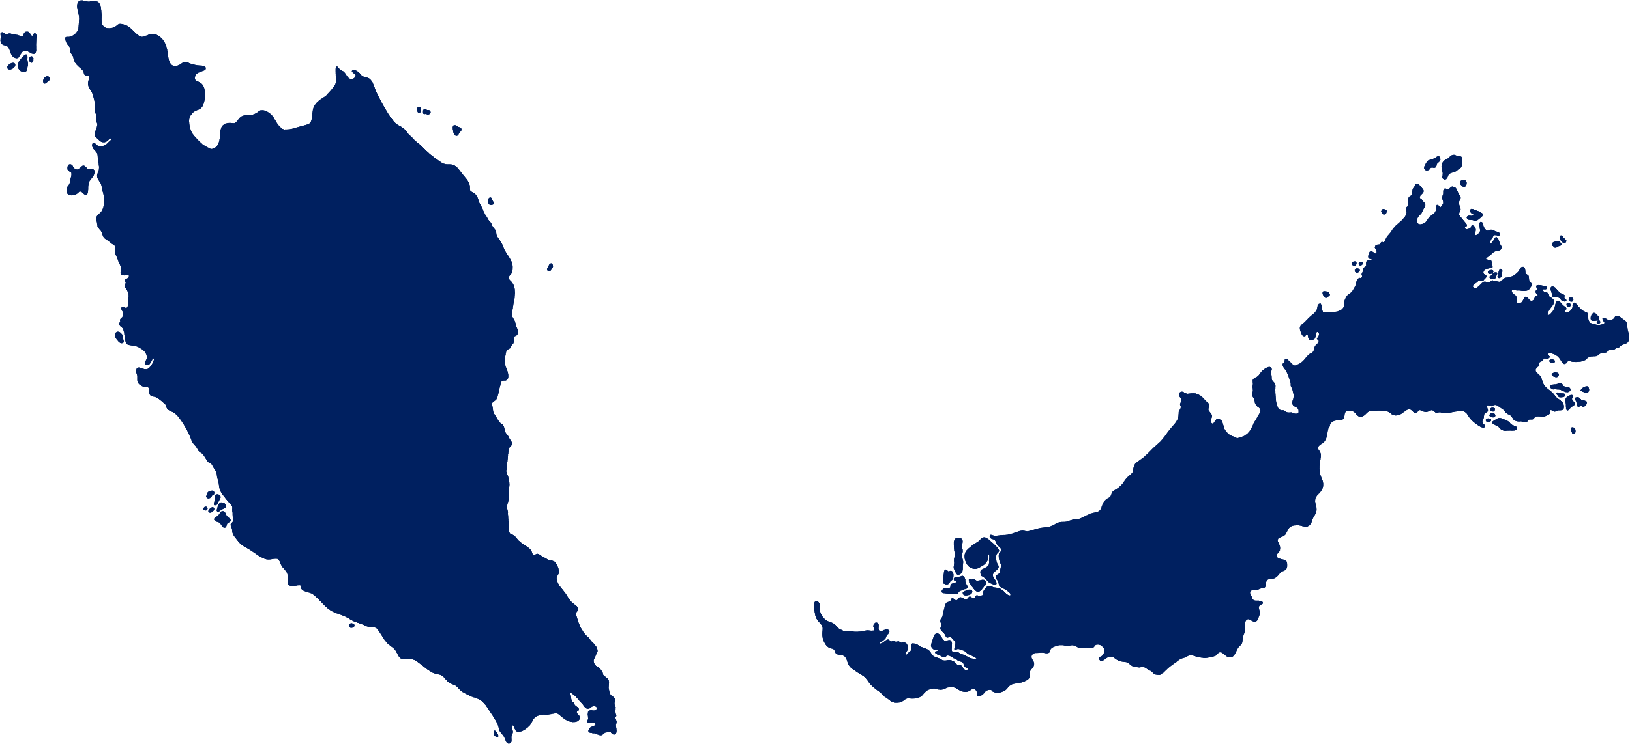





7 million talents in
more than 200 countries
4.2M (65%) cross SEA and Taiwan region
18% from the US, and 8% from India.
🇮🇩 🇲🇾 🇸🇬 🇹🇼 🇻🇳 🇺🇸 🇮🇳 🇯🇵
Reported by
Backed by

Slide 3


Logistics & Supply Chain
Warehouse & Transportation
IT Solutions for logistics
Supporting Logistics Services
Project Logistics
Technology
Information technology
Consumer electronics
Manufacturing
Semiconductor
Consumer
FMCG
Food and beverage
Financial
Financial Holding
Banking & Investment
Our Record
1125+ Clients
Cake Helps Companies Fill the Talent Gap

Slide 4

Our Total Recruitment Services
Headhunting Service
Executive Search
Permanent Placement
Talent Mapping
EoR / Payroll Service
Employer of Record
Conduct local payroll, taxes, benefits, and compliance

Slide 5

Headhunting Service

Slide 6
Our Strength
7+ Millions of huge talent database
Cake AI + MarTech
Faster sourcing and matching with Cake AI
Web Crawler in different kinds of talent platforms
Using Marketing Technology to engage more potential talents and Job Post Marketing
Ground Search + Direct Sourcing
Recruitment Consultant will provide insights and sourcing strategic for talent search
Identify relevant and potential client competitors, and engage in comprehensive talent acquisition and market research across all channels.
Expert Recruiters
Our extensive background in Technology & Commercial helps us better understand your business goals and Hiring needs.
Timely and Precising knows talents movement
360-degree consulting recruitment process

Slide 7

Recruit the right talent in the most efficiency
From Senior to High Management Partner in all kinds.
CHALLENGES
Need for speed
Fill in roles as soon as possible for businesses or operation growth
Difficulty in finding talents
Hard to find the suitable talents or always the talents are snatched by other companies.
Confidential
High level position, Replacement issue etc.
HEADHUNTING SOLUTIONS
Executive Search
Providing total Recruitment Process by sourcing suitable Hard/Soft skills talents until fulfill the positions according to your hiring needs.
Talent Mapping
Tailor-made program. Listing the direct sourcing companies with Organization, Target Candidates information, motivation and all aspect etc.
RESULTS
General Positions: 3-5 days provide CV immediately
Ground searching the multiple talent platforms and Database. Do extremely engage with Candidate, discover motivation and introduce the specific opportunities.
More options to find the suitable talents
Compared with traditional recruiting agency, we generated over more than 30% of CV numbers.

Slide 8
Expert Process
Client
Engage
Assignment of a professional recruiter to your organization who gains a detailed
understanding of your business, its structure, its challenges and its culture.
Client
Interview
Assist both Client and the candidate in preparation for the interview and selection process.
Search
& Screen
Utilize our extensive database, far-reaching network, connections, and Cake AI
search via multiple platforms, as required.
Follow
up
Keep follow up during the period with Client and candidate. Provide a timely feedback about candidate and completely your hiring needs.
Every candidate that presents has been extensively interviewed, with our recruiters gaining a detailed understanding of their skills, attributes and true capabilities.
Offer negotiation for both you and the successful candidate through to an employment contract.
Also, we will keep following up with candidate till the onboarding.
Recruiter
Interview
Offer
Stage
On board
&
Guarantee
Make sure candidate on boarding and keep following up. We offer Guarantee period for each candidates to make sure our Client satisfy the talent.
Profile
Send
Introduce to you for the best-fit candidates and with completed information/recommendation

Slide 9
Expert Functions
Recruiters' expertise led to the division of the team into four main functions
Sales & Marketing
Supply chain, logistics
Operations
Engineering
Successful Placements
Country Manager Chief Revenue Officer (Confidential) Chief Growth Officer Head of Marketing Business Development Director Sales Manager/Director Regional Marketing Manager | Head of Warehouse. Business Development Director (Confidential) General Manager (Confidential) Supply Chain Manager General Director APAC. (Confidential) Chief Accountant (Confidential) Operations Manager Head of Purchasing BDM (E-C Speaking) | Chief Finance Officer (C0nfidential) Finance Manager Regional Finance Controller(Confidential) HR Director (Confidential) Senior Operations Director (C0nfidential) Total Reward Manager | Plant Director (Confidential) Lean Director Group Merchandising Manager Design Manager Asia Corporate Responsibility Manager Production Manager Production Director – Chinese speaking

Slide 10
EoR / Payroll Service

Slide 11
Handling your employees in the most efficiency & Riskless
We handles payroll, benefits, taxes, insurance and local compliance on your behalf.
We offer your employees
Offering
We hire and offer your employees in accordance with local laws.
HR Consultancy
Our Recruiters with solid HR operation know-how. Your employees will feel more protection about their labor rights and reduce your turnover rate.
Full-time / Contract
Agile and nimble for your Business expansion and strategy.
We manage compliance for you
Compliance
We take care of payroll calculations, insurance, pensions and tax etc.
Termination
If you are no longer needs the employee. We can assist after the Employment Termination process.
Workplace & invention
We could assist you to find the local Workplace and increase your employees working efficiency and relationship, depends on your needs.

Slide 12
Thank you!
Where Talent Meets Opportunities: Discover People, Unlock Possibilities.

